Slide 1


Financial Impact of Hurricanes on US Publicly-Traded REITs from 1995-2020
Team A - December 16, 2021
Notes:
Maddie

Slide 2
Team A
Project Management
Data Team
Modeling Team
Maddie
Aansh - Property & company data expert
Zixin
Uli - Hurricane data expert
Zilin
Advisors
Vincent Agboto - Professor
Jingshu - Data joining & visualization
Yicheng
Allen Chang - Associate
Raven - Data joining & visualization
Zehua
Notes:
Maddie

Slide 3


Background
Since 1980, hurricanes in the US have caused at least $945.9 billion in damage²
Hurricane rainfall levels are expected to increase on average by the end of the century¹
Businesses want to know how this will impact them - and S&P wants to be able to answer this question for their clients
Hurricane intensities are expected to increase on average by the end of the century¹
Source:
1. Geophysical Fluid Dynamics Laboratory (https://www.gfdl.noaa.gov/global-warming-and-hurricanes/)
2. National Oceanic and Atmospheric Administration (https://coast.noaa.gov/states/fast-facts/hurricane-costs.html)
Notes:
Maddie

Slide 4
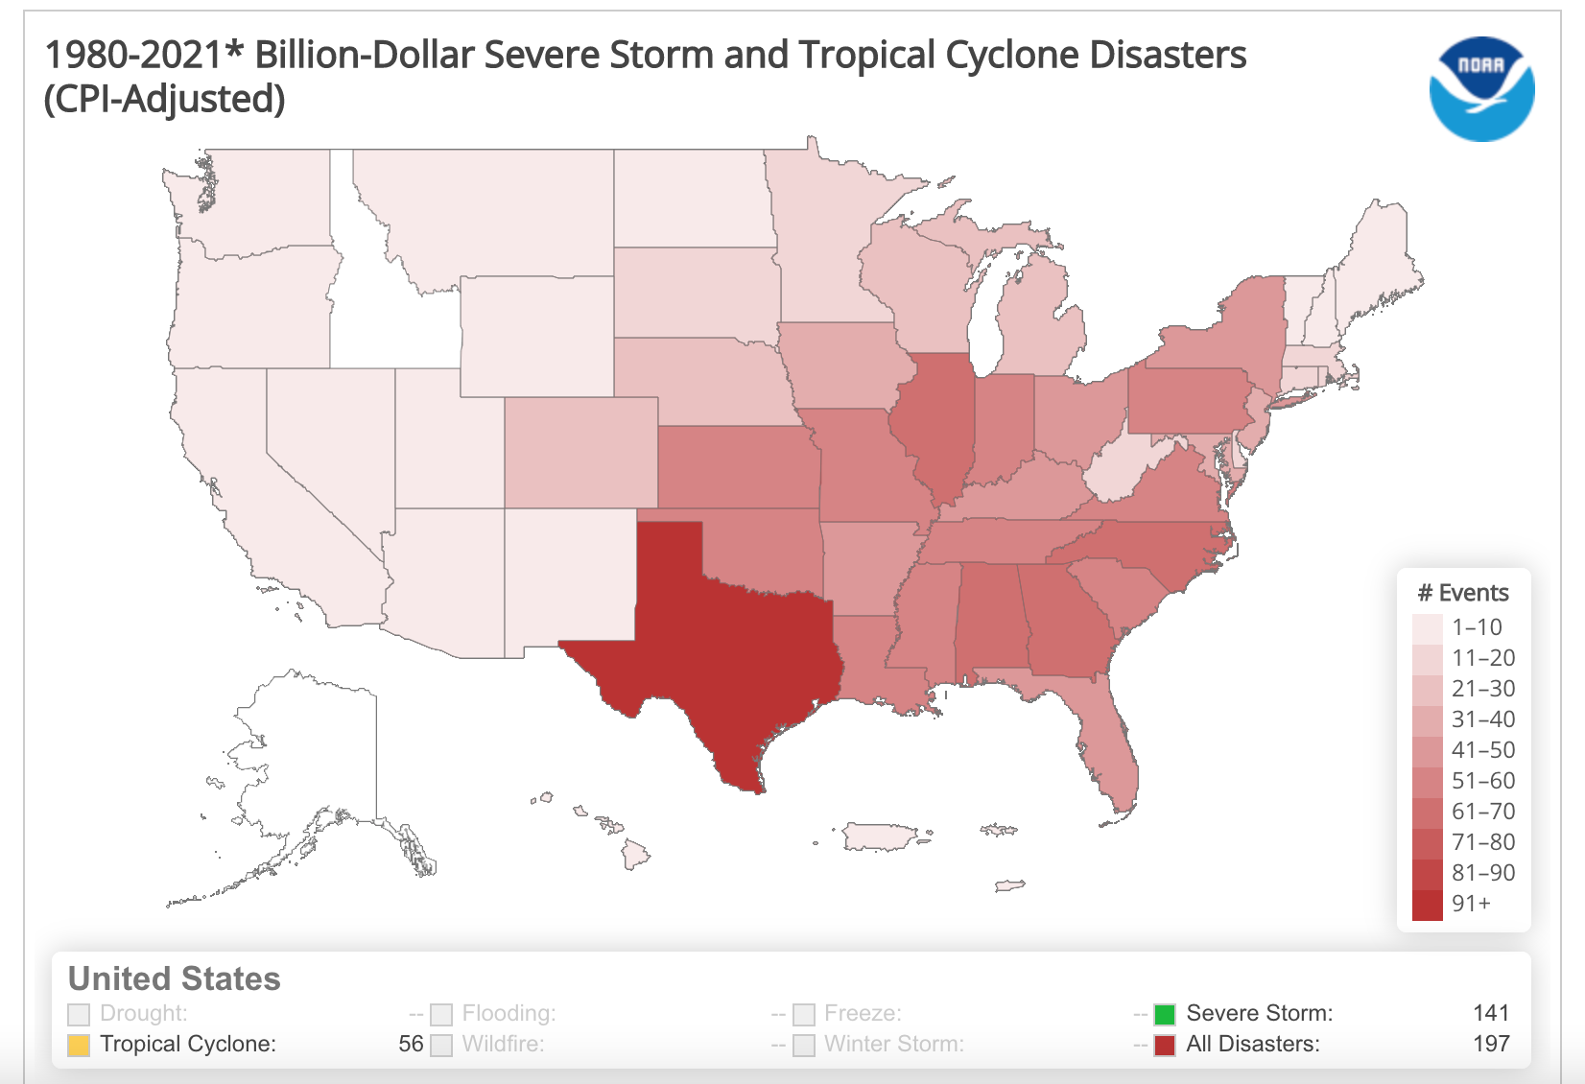
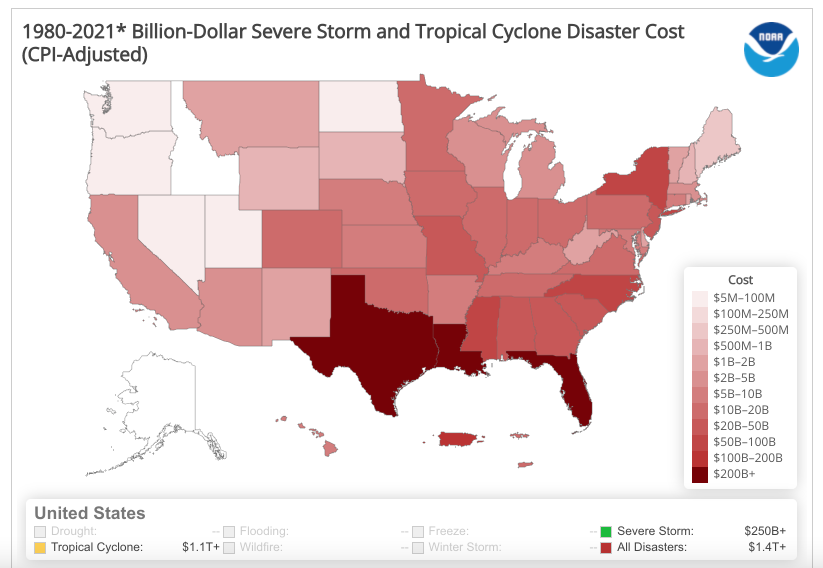
Background
^{Number of Hurricanes per State}
^{Cost of Hurricanes per State}
NOAA National Centers for Environmental Information (NCEI) U.S. Billion-Dollar Weather and Climate Disasters (2021). https://www.ncdc.noaa.gov/billions/, DOI: 10.25921/stkw-7w73
Notes:
Maddie

Slide 5
Research Question
What is the relationship between hurricane intensity and the financial loss of impacted companies?
Hurricane intensity measured by maximum wind speed per year and number of hurricane encounters
Impacted companies defined to be any companies within a 50 mile radius of hurricane landfall
Financial loss defined to be asset write downs
Notes:
Zixin

Slide 6
Methodology
1
Understand the structure of the data:
What financial data is available over which years
How hurricane data is presented
Features to join the financial data with hurricane data
Specific attention to geolocation ( longitude and latitude of hurricane or property)
2
Define scope of research:
Years: 1995-2020 based on available data
Publicly traded companies because those are the ones with more data available
Hurricanes which pass through the US because that’s the country we will look at economic control factors for
3
4
Define analytical methods to use for each research question:
Goal is to understand real estate sector losses due to hurricanes
Pull macroeconomic data (GDP, inflation rate) to use as control variables
Build regression models on key variables
Iteratively evaluate and improve models based on:
Predictive ability of models
Interpretability of models
Notes:
Zixin

Slide 7
Data - Hurricanes
IBTrACS data of North Atlantic Area¹
ADT-HURSAT Data²
Hurricane data from 1842-2021
Intensity (wind speed) data less reliable because does not address differences in measuring techniques across times and places
Includes indicators of which storms hit the US
Most useful data attribute will be the landfall information
Hurricane data from 1978-2017
Addresses inconsistencies in measuring techniques present in other datasets
Created by applying the advanced Dvorak Technique to a globally homogenized record of geostationary satellite imagery
Lacks indication of whether or not storms made landfall at all
Most useful data attribute will be wind speed
Indicator of Landfall Information
More Reliable Wind Speed Data
Source:
1. National Oceanic and Atmospheric Administration (https://www.ncdc.noaa.gov/ibtracs/index.php?name=ib-v4-access)
2. Proceedings of the National Academy of Sciences of the United States (https://www.pnas.org/content/suppl/2020/05/12/1920849117.DCSupplemental)
Notes:
Jingshu

Slide 8
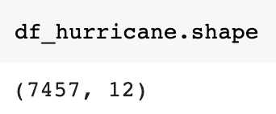
Initial Data Cleaning - Hurricanes
Data Cleaning Methods
After cleaning, here’s the shape of our hurricane dataset
Recall, the only attribute we want to use from ADT-HURSAT¹ data in our final model is wind speed
First, we filter our IBTrACS dataset to include only hurricanes that made landfall
Next, we merge two datasets by storm_id to have storm surface wind speed from ADT-HURSAT data for hurricanes that have landfalls
Lastly, our dataset contains the wind speed data from ADT-HURSAT dataset before 2017, and from IBTrACS dataset for 2017-2020
Here’s an example of what it looks like
Source:
1. Proceedings of the National Academy of Sciences of the United States (https://www.pnas.org/content/suppl/2020/05/12/1920849117.DCSupplemental)
2. National Oceanic and Atmospheric Administration (https://www.ncdc.noaa.gov/ibtracs/index.php?name=ib-v4-access)
Notes:
Jingshu

Slide 9
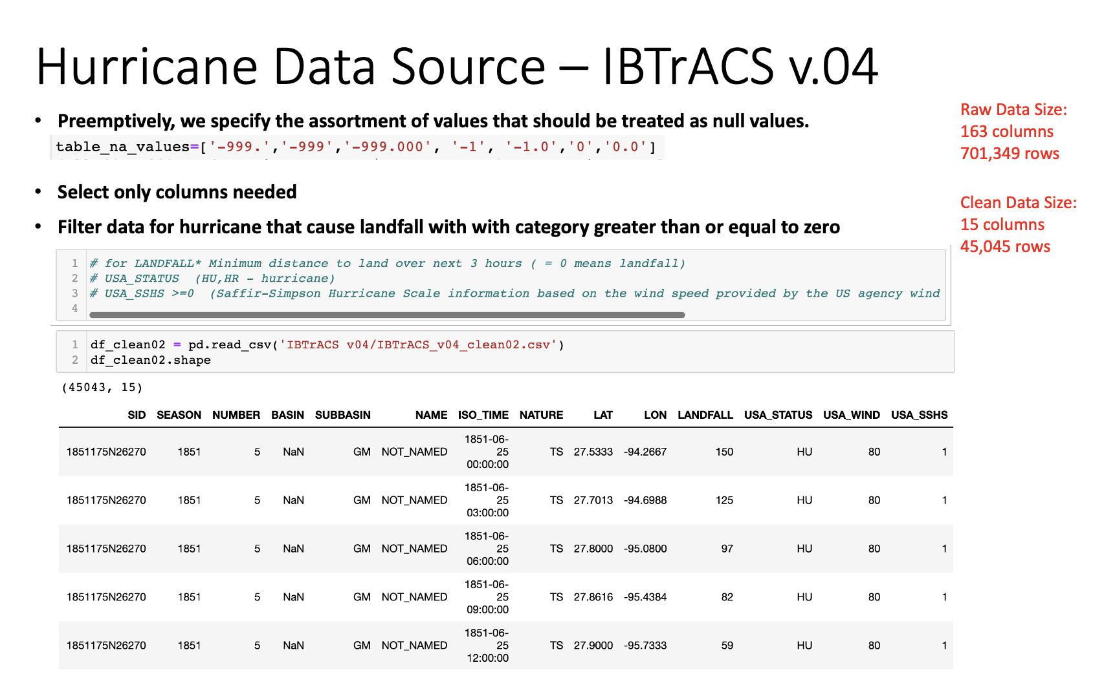
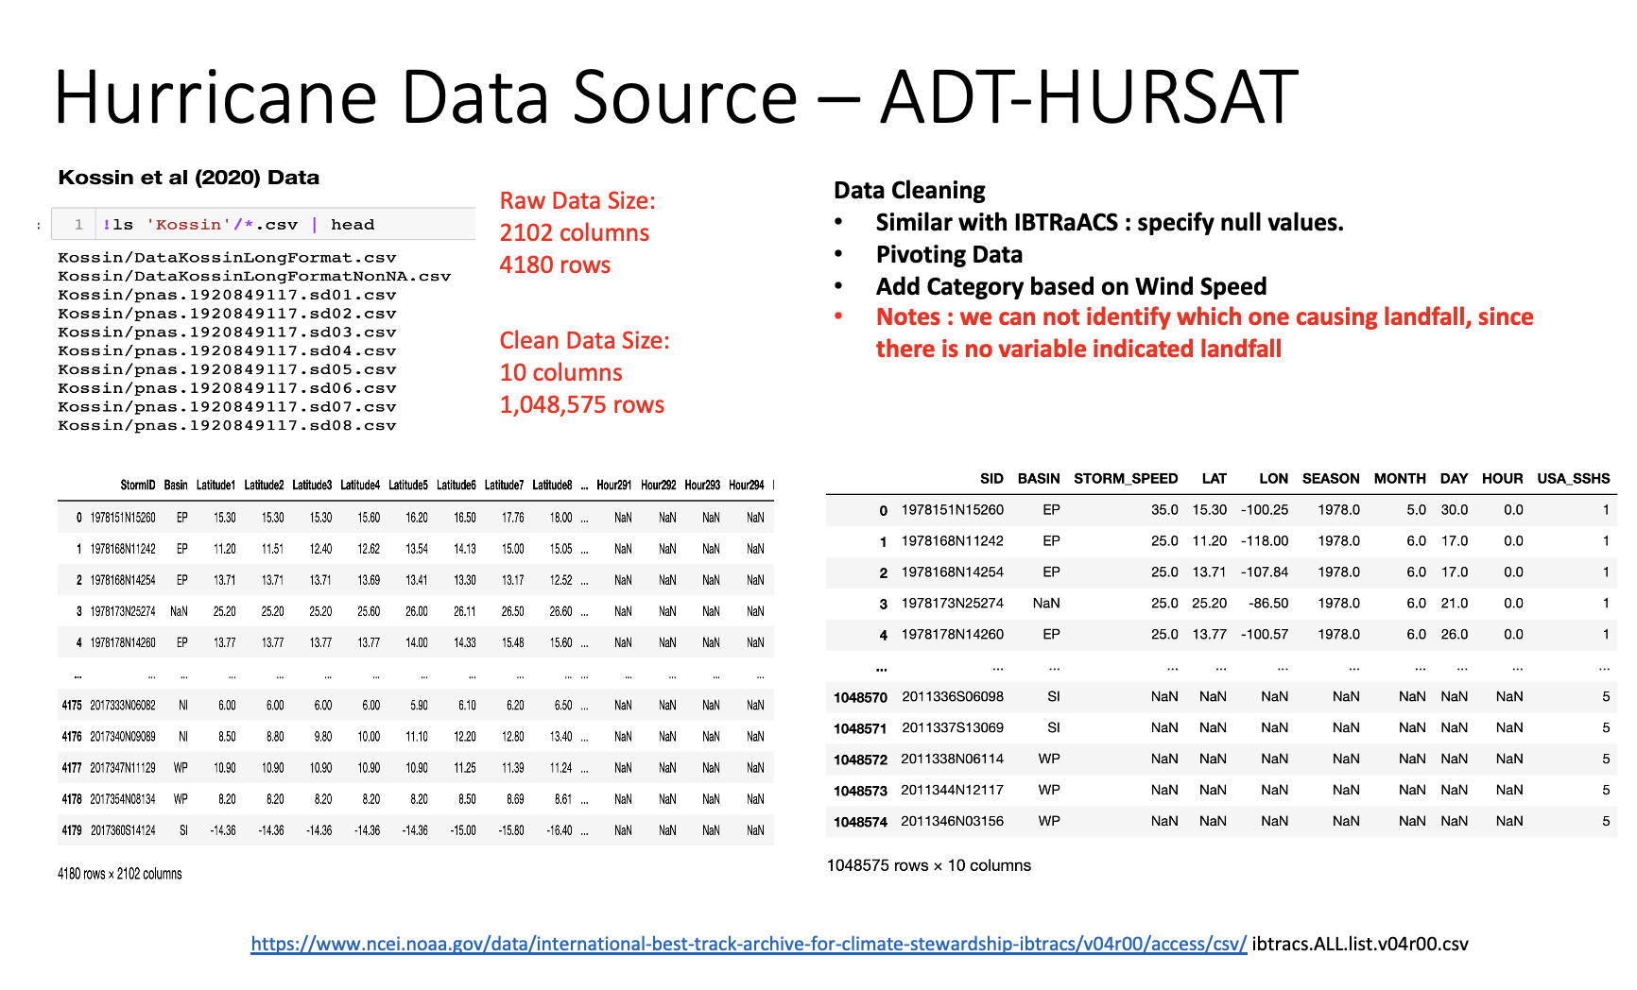
Initial Data Analysis - Hurricanes
Notes:
Uli

Slide 10
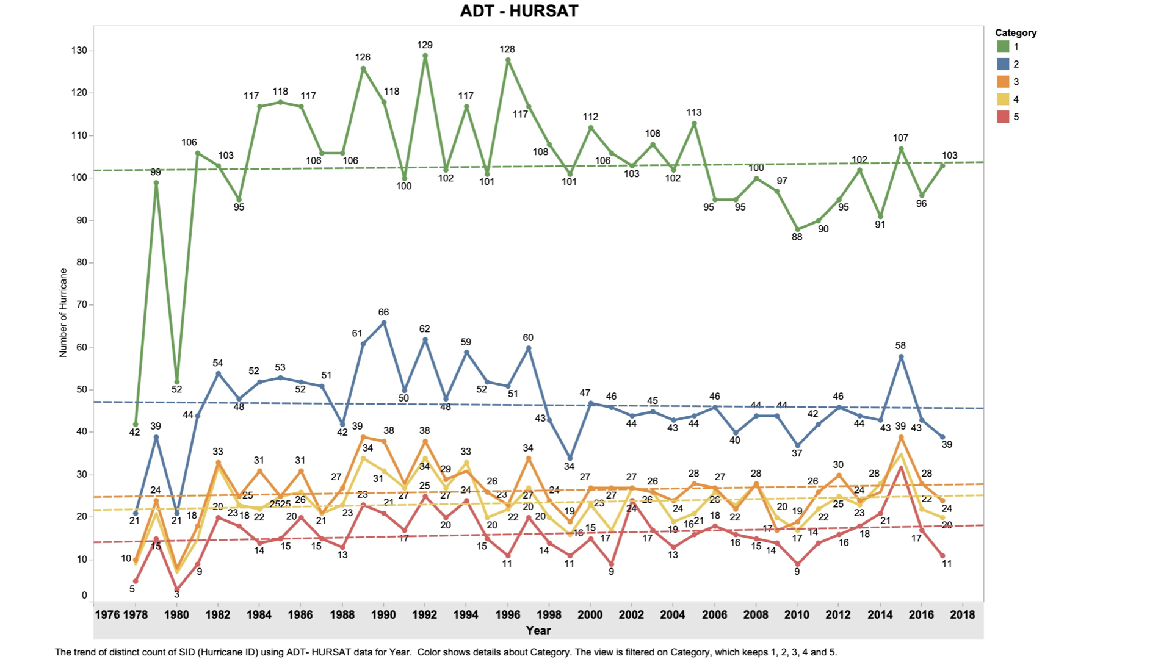
Initial Data Analysis - ADT-HURSAT
The trend based on distinct count of Hurricane ID using ADT-HURSAT - global data of 1978-2017

Slide 11
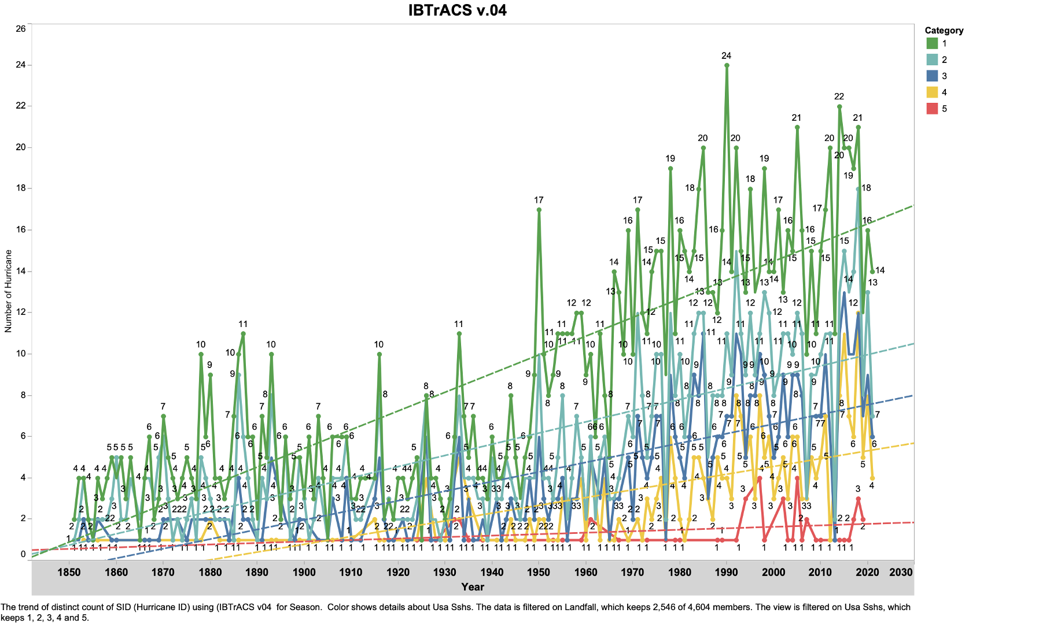
Initial Data Analysis - IBTrACS
The trend based on distinct count of Hurricane ID using IBTrACS v04 - global data of 1842-2021

Slide 12
Data - Real Estate
Data Source
Key Data Attributes
Pulled using S&P proprietary tool, S&P Capital IQ Pro¹
Property-level data pulled from Asset data feature for Real Estate Properties
Scope: US-based publicly-traded REITs - currently owned and sold properties
Years: 1995-2020
Property locations (longitude and latitude)
Total company assets
Asset write down
We will use property-level data to identify hurricane encounters, but will look at company-level financial data (since this is often not available on a property level)
Source:
1. S&P Capital IQ Pro (https://www.capitaliq.spglobal.com/web/client?auth=inherit#dashboard)
Notes:
Aansh

Slide 13
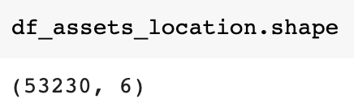
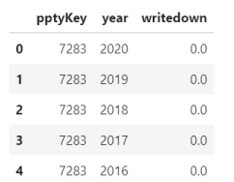
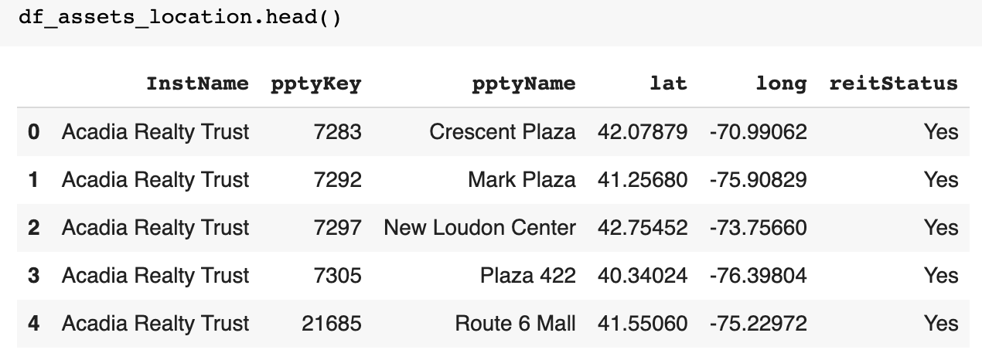
Initial Data Cleaning - Real Estate
Data Cleaning Methods
After cleaning, here’s the shape of our assets dataset
First, we want to be able to track asset values yearly - so we reformat that data to be tall instead of wide and put it into its own dataset
Then, we want to see the locations of all our assets - so we reformat that data into its own dataset as well
In both datasets, we keep the property ID so we can later use this to link our datasets together
Here are what the heads of those datasets look like
Source: S&P Capital IQ Pro (https://www.capitaliq.spglobal.com/web/client?auth=inherit#dashboard)
Notes:
Aansh

Slide 14
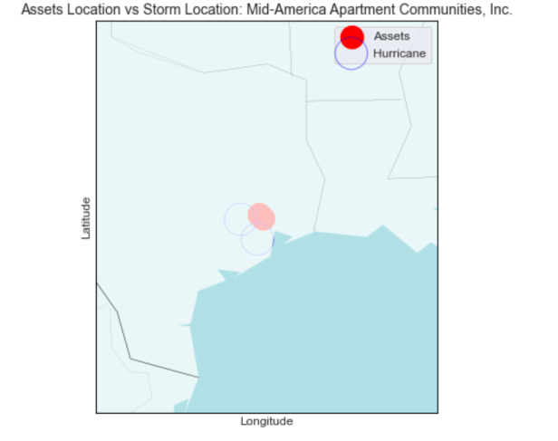
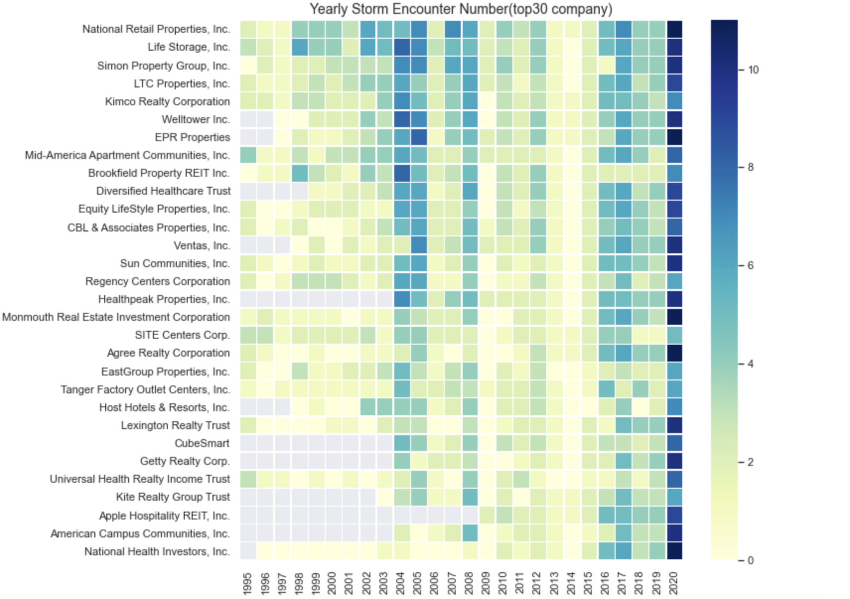
Joining Real Estate & Property Data Together
Joining Methods
Top 30 Companies with the Most Storm Encounters
Company
Connected via latitudes and longitudes of property location and hurricane landfall
Looked at hurricanes with landfall within a 50 mile radius
Analysis done on data from:
1. S&P Capital IQ Pro for company data (https://www.capitaliq.spglobal.com/web/client?auth=inherit#dashboard)
2. National Oceanic and Atmospheric Administration for hurricane data (https://www.ncdc.noaa.gov/ibtracs/index.php?name=ib-v4-access)
3. Proceedings of the National Academy of Sciences of the United States (https://www.pnas.org/content/suppl/2020/05/12/1920849117.DCSupplemental)
Year
Notes:
Raven

Slide 15
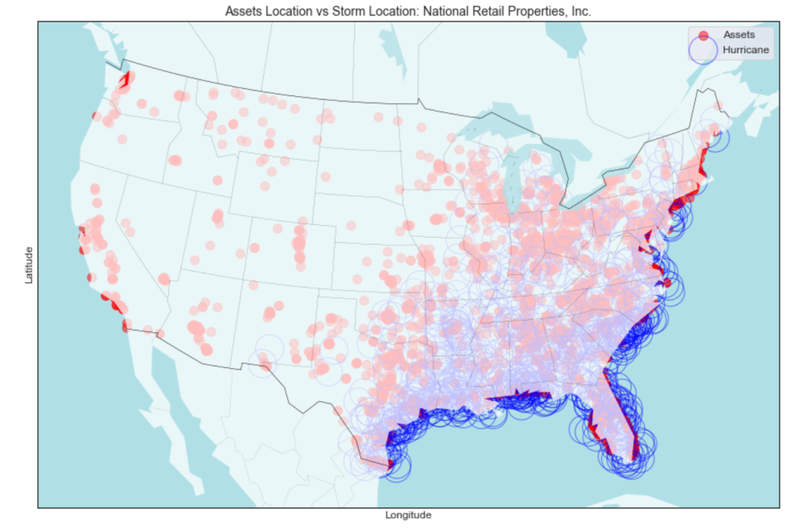
Inspecting the Data - An Example of One Company
Data Inspection Methods
Using our asset & hurricane datasets connected by latitude and longitude, we plotted the assets of that company and the storms that affected them
We did this for the top five companies hit by the most storms
The other four companies’ plots are available in the appendix
Analysis done on data from:
1. S&P Capital IQ Pro for company data (https://www.capitaliq.spglobal.com/web/client?auth=inherit#dashboard)
2. National Oceanic and Atmospheric Administration for hurricane data (https://www.ncdc.noaa.gov/ibtracs/index.php?name=ib-v4-access)
3. Proceedings of the National Academy of Sciences of the United States (https://www.pnas.org/content/suppl/2020/05/12/1920849117.DCSupplemental)
Year 1995 - 2020
Notes:
Raven

Slide 16
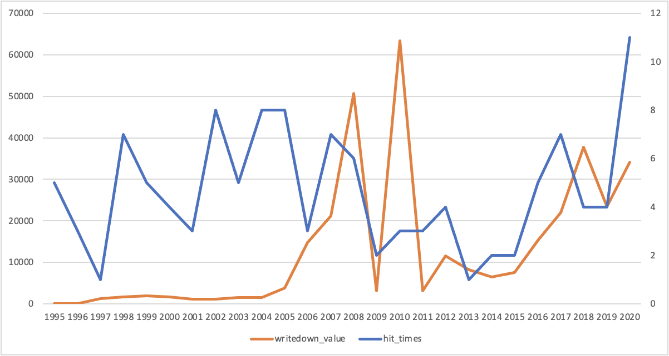
Inspecting the Data - An Example of One Company
Total Asset Write-down Value & Total Hurricane Hit times
by Year: Macerich Company
Data Inspection Methods
Graphing how company assets write down value changed over time for our selected companies with the most hurricane hits - only one of those graphs is shown here
Next step will be to incorporate this data into modeling to see how it is changing in correlation with hurricane hits (and the strength of those hits)
Total Write Down Value (in thousands of USD)
Total Hurricane hit times in a year
Analysis done on data from:
1. S&P Capital IQ Pro for company data (https://www.capitaliq.spglobal.com/web/client?auth=inherit#dashboard)
2. National Oceanic and Atmospheric Administration for hurricane data (https://www.ncdc.noaa.gov/ibtracs/index.php?name=ib-v4-access)
Year
Notes:
Zilin

Slide 17
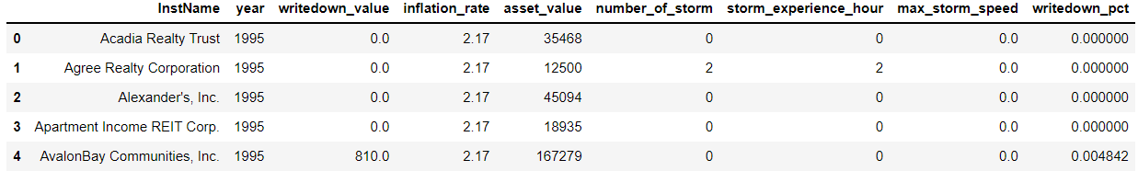
Dataset after cleaning
InstName: name of the institution
year: year
writedown_value: write down value of real estate that year
inflation_rate: US inflation rate that year
asset_value: total asset value of the company
number_of_storm: number of storm encountered that year
storm_experience_hour: duration of storm
max_storm_speed: maximum value of storm wind speed
writedown_pct: The proportion of write down value over asset value
Analysis done on data from:
1. S&P Capital IQ Pro for company data (https://www.capitaliq.spglobal.com/web/client?auth=inherit#dashboard)
2. National Oceanic and Atmospheric Administration for hurricane data (https://www.ncdc.noaa.gov/ibtracs/index.php?name=ib-v4-access)
All the companies which are in this dataset have been impacted by the hurricane
Notes:
Zilin

Slide 18
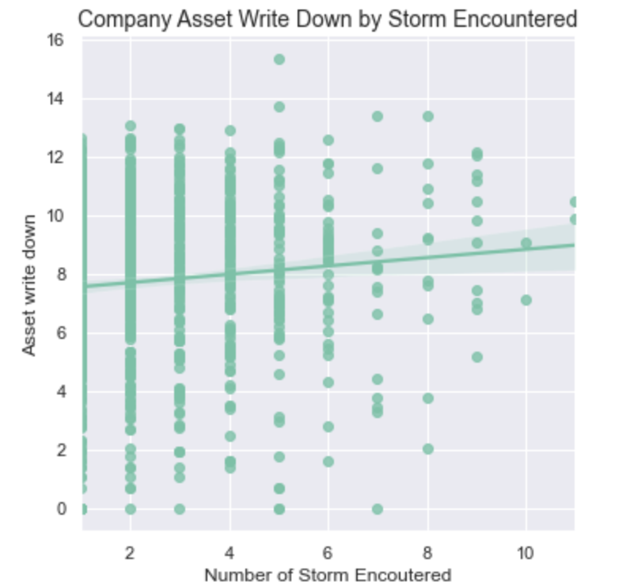
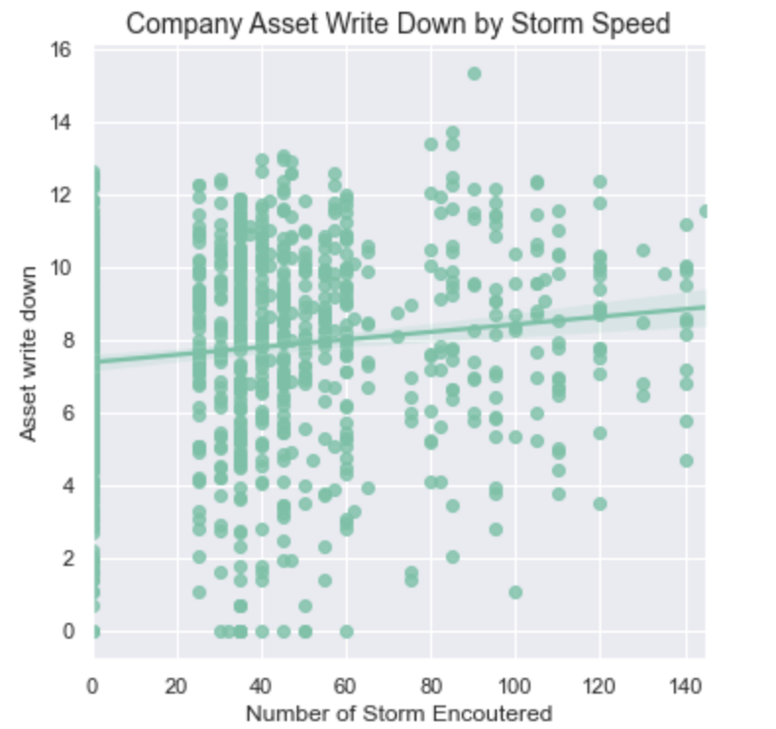
Inspecting Data - All Affected Companies
Asset Write Down VS. # of storm Encountered
Asset Write Down VS. Storm speeds
210 Firms
Affected by storms
With writedown_value
With max_speed
Analysis done on data from:
1. S&P Capital IQ Pro for company data (https://www.capitaliq.spglobal.com/web/client?auth=inherit#dashboard)
2. National Oceanic and Atmospheric Administration for hurricane data (https://www.ncdc.noaa.gov/ibtracs/index.php?name=ib-v4-access)
Notes:
Zilin

Slide 19
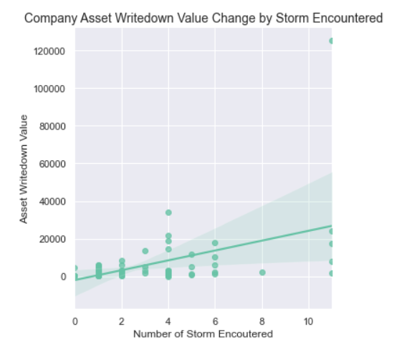
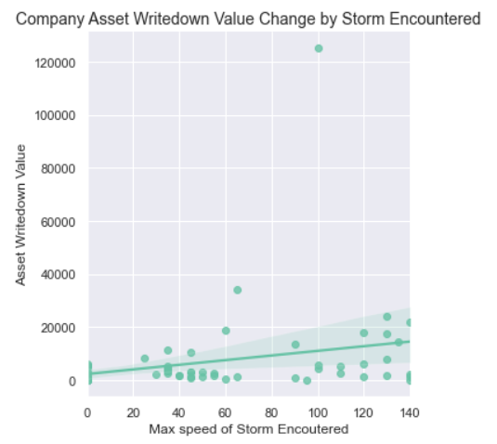
Inspecting Data - Top 5 firms
Asset Write Down VS. # of storm Encountered
Asset Write Down VS. Storm speeds
Analysis done on data from:
1. S&P Capital IQ Pro for company data (https://www.capitaliq.spglobal.com/web/client?auth=inherit#dashboard)
2. National Oceanic and Atmospheric Administration for hurricane data (https://www.ncdc.noaa.gov/ibtracs/index.php?name=ib-v4-access)
Notes:
Zilin

Slide 20
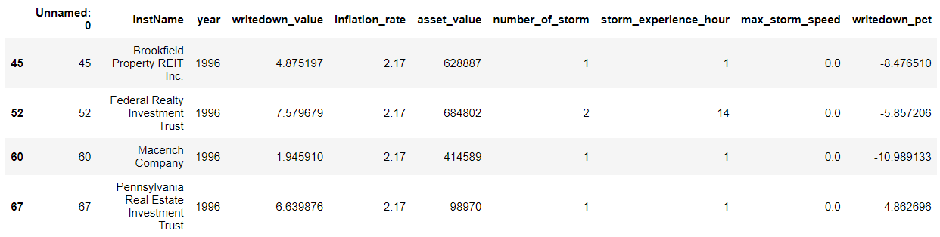
Data Preparation for Regression Modeling
1. Delete the records that the number of storms is 0 that year;
2. Delete the records that the write down value is 0 that year;
3. Logarithmic conversion writedown_pct and writedown_value to reduce skew distribution;
4. Independent variables: inflation_rate, number_of_storm, max_storm_speed, storm_experience_hour;
5. Dependent variables: writedown_value or writedown_pct.
Notes:
Zilin

Slide 21
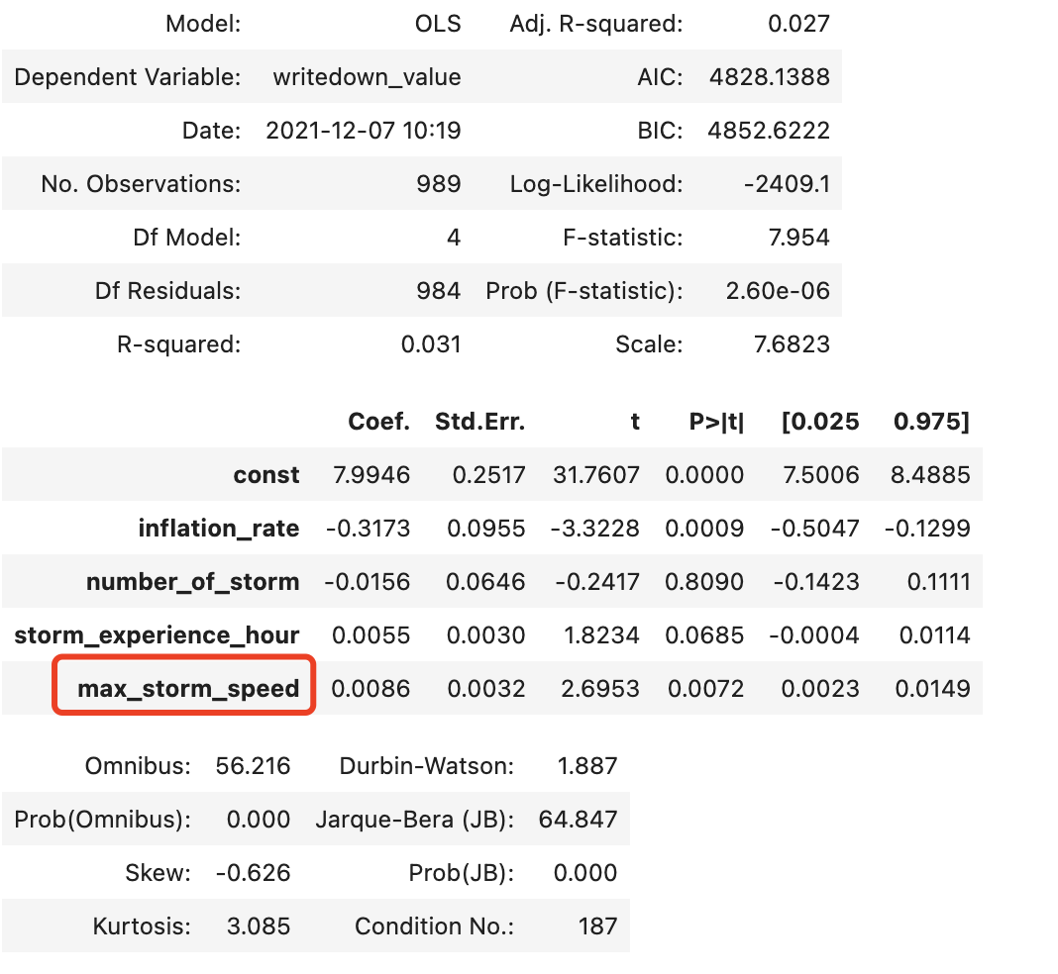
Linear Model
Asset Write Down VS. # of storm Encountered （ 210 Companies selected）
The p value of max_storm_speed is lower than 0.05, which means it is significant.
And the coefficient of it is 0.0086, which is positive. So it means that the larger the max storm speed is, the higher the write down value of the companies will be which means the companies lost more in hurricane.
However, r2 was 0.031, it means that the model was not good on predicting the results. It may not be accurate enough.
Analysis done on data from:
1. S&P Capital IQ Pro for company data (https://www.capitaliq.spglobal.com/web/client?auth=inherit#dashboard)
2. National Oceanic and Atmospheric Administration for hurricane data (https://www.ncdc.noaa.gov/ibtracs/index.php?name=ib-v4-access)
Notes:
Zehua

Slide 22
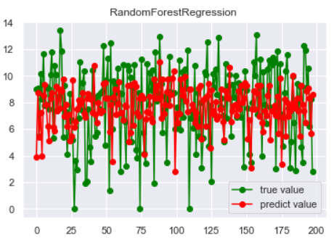
RandomForestRegressor
MAPE means Mean Absolute Percentage Error, which can somehow show the accuracy of the regression model
MAPE:41.11%
Analysis done on data from:
1. S&P Capital IQ Pro for company data (https://www.capitaliq.spglobal.com/web/client?auth=inherit#dashboard)
2. National Oceanic and Atmospheric Administration for hurricane data (https://www.ncdc.noaa.gov/ibtracs/index.php?name=ib-v4-access)
Notes:
Zehua

Slide 23
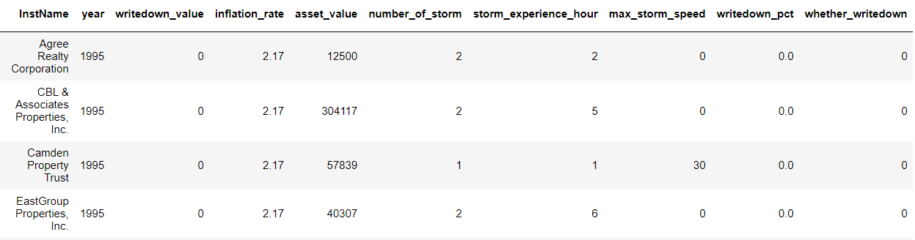
Data Preparation for Classification Modeling
Add a new column to represent whether the company had write down value recorded or not;
The value can be 0 if the company didn’t have write down value;
The value can be 1 if the company had write down value;
Independent variables: inflation_rate, number_of_storm, max_storm_speed, storm_experience_hour;
Dependent variables: whether_writedown.
Notes:
Zilin

Slide 24
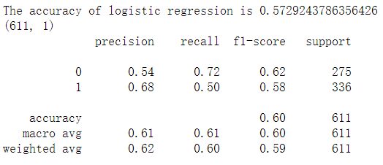
Logistic Regression
Asset Write Down(0 or 1) VS. # of storm Encountered
（ 210 Companies selected）
Accuracy:
The correctly predicted samples / all test samples
Analysis done on data from:
1. S&P Capital IQ Pro for company data (https://www.capitaliq.spglobal.com/web/client?auth=inherit#dashboard)
2. National Oceanic and Atmospheric Administration for hurricane data (https://www.ncdc.noaa.gov/ibtracs/index.php?name=ib-v4-access)
Notes:
Yicheng

Slide 25
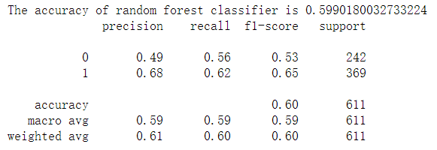
Random Forest Classifier
Asset Write Down(0 or 1) VS. # of storm Encountered
（ 210 Companies selected）
Analysis done on data from:
1. S&P Capital IQ Pro for company data (https://www.capitaliq.spglobal.com/web/client?auth=inherit#dashboard)
2. National Oceanic and Atmospheric Administration for hurricane data (https://www.ncdc.noaa.gov/ibtracs/index.php?name=ib-v4-access)
Notes:
Yicheng

Slide 26

Areas for Further Exploration
Given additional time we would explore the following areas
Extend historical data for both hurricanes and real-estate assets
Systematic analysis of all company statements and earnings calls for firms that experienced hurricanes
Conduct comparable studies in adjacent industries
Insurance
Notes:
Zixin to write this
Aansh to talk

Slide 27
Lessons Learned
Assigning roles to team members kept us organized and accountable.
Through iterative presentations and feedback, we learned what visuals and presentations styles best conveyed our message:
We should show our complete process, including issues, rather than only showing what worked well
We should start with simple examples and then extrapolate to larger populations
We should ensure all sources were well-cited and our rationale for using them explained
Using business logic was very helpful in determining which features to use in our model. For example, asset write down was more closely related to hurricanes than total asset value.
Refining our initial three research questions into one question kept us focused on the specific business need.
Some models were computationally expensive, and we had to consider computing power when building our models.
Notes:
Aansh

Slide 28
Questions?

Slide 29
Appendix

Slide 30
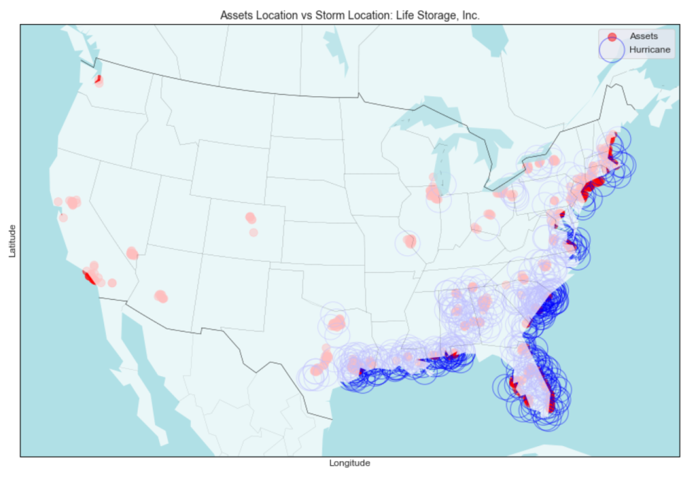
Inspecting the Data - Mapping Example #2

Slide 31
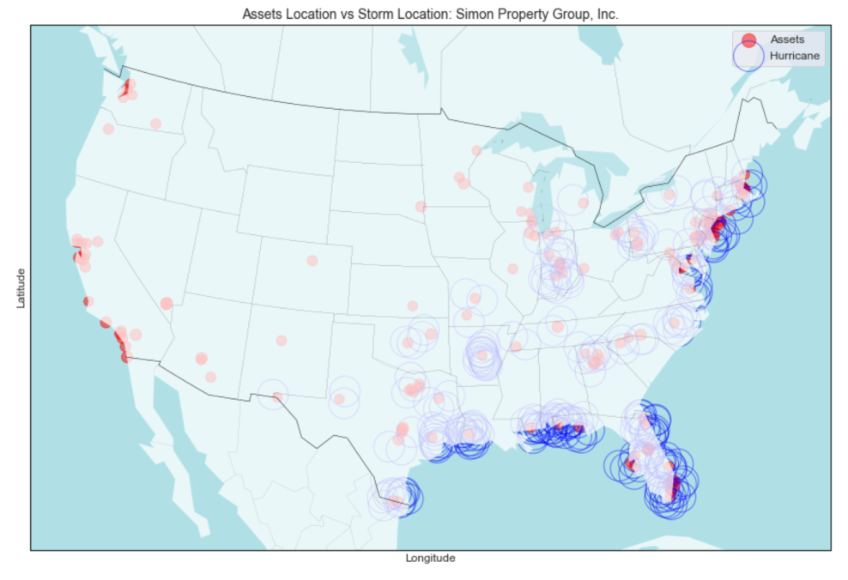
Inspecting the Data - Mapping Example #3

Slide 32
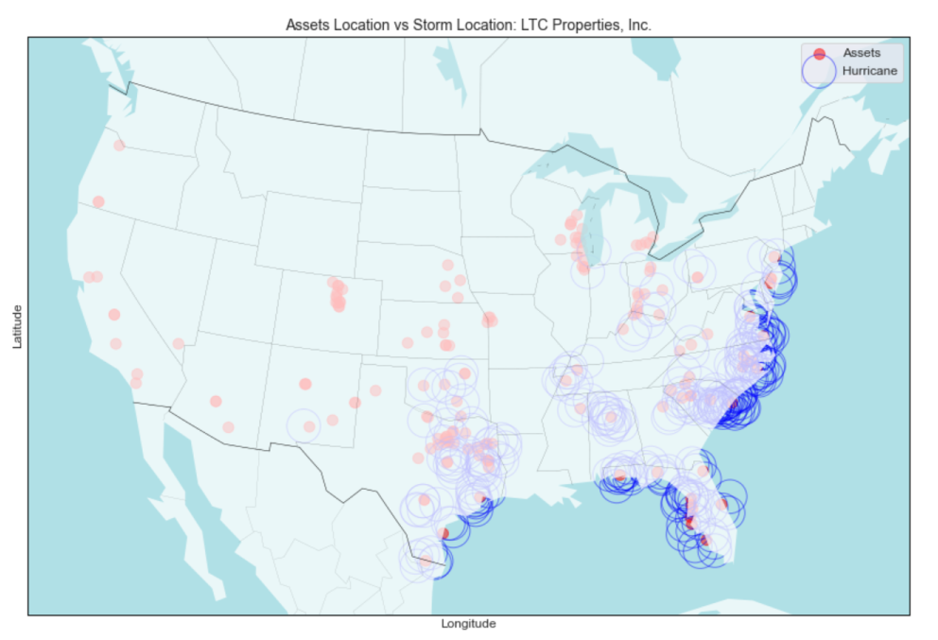
Inspecting the Data - Mapping Example #4

Slide 33
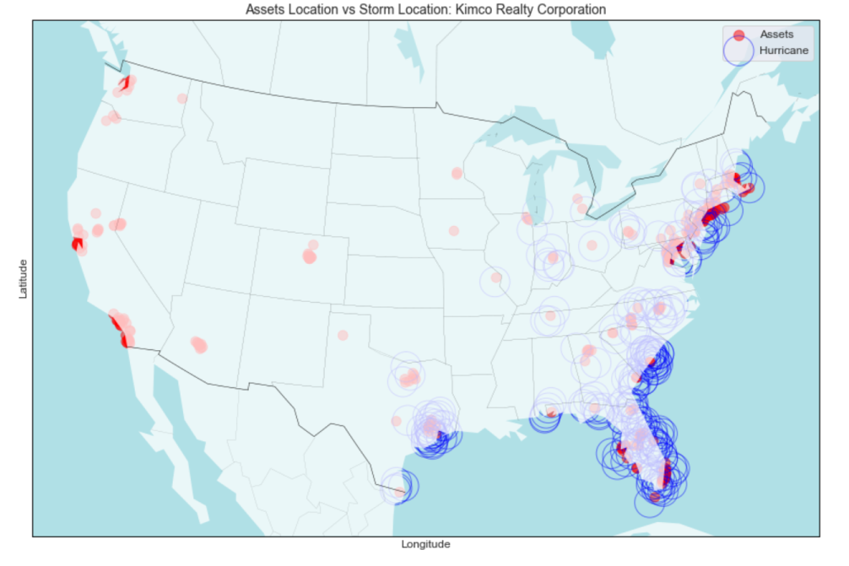
Inspecting the Data - Mapping Example #5

